Slide 1

Git (Distributed Version Control System)
Alexandre DINH-DEBOUNY

Slide 2
Installation

Slide 3
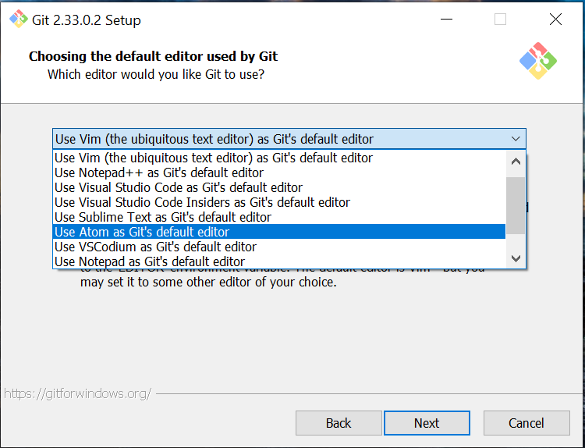
Select Atom as default editor
After having downloaded Git on https://git-scm.com/ , run the .exe file.
During install, I suggest you choose Atom as default editor
For the other steps, always click on Next

Slide 4
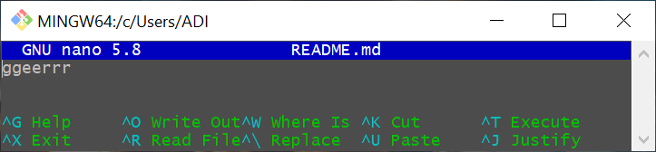
Atom editor
You need to download on https://atom.io/ .
To open (and create a new file if it doesn’t exist) : nano <File_Name>
The following commands to use :
Ctrl + Insert : to copy content
Shift + Insert : to paste content
CTRL + O : to save the file (you must confirm the operation by typing Enter)
CTRL + X : to exit the editor

Slide 5
Configuration

Slide 6
Git config levels
Git uses a series of configuration files to determine non-default behavior that you may want.
--local
Current project configs stored in .git/config in the project’s directory.
--global
Global configs are available for all projects for the current user and stored in C:/Users/AD_User/.gitconfig
--system
System configs are available for all the users/projects and stored in C:/Program Files/Git/etc/gitconfig.
Where we’ll set :
The Commit author’s name & email
The Merging process options

Slide 7
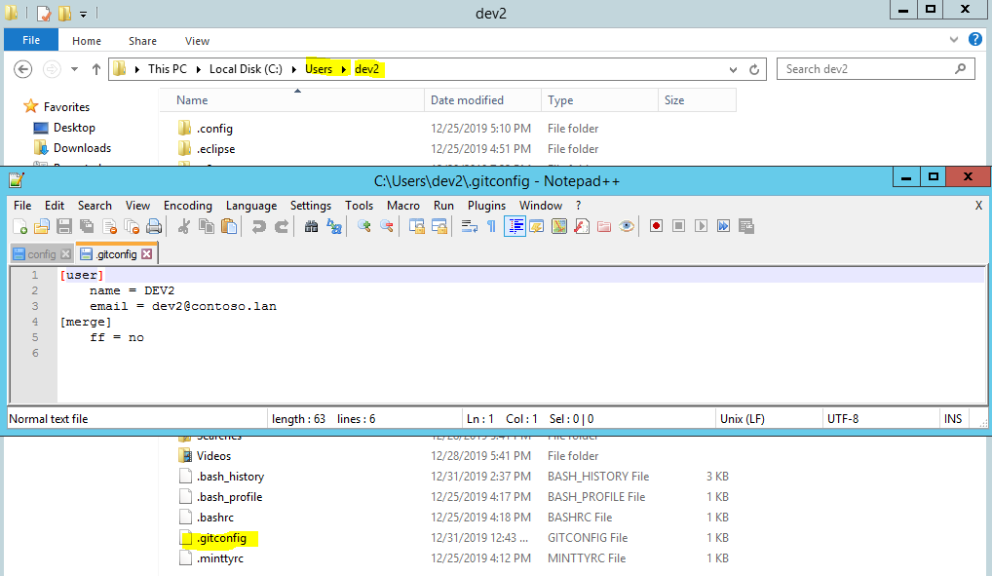
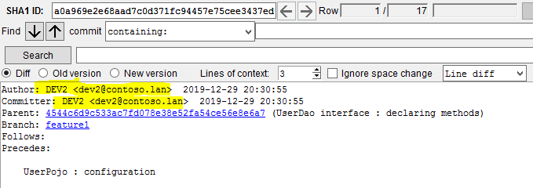
Git (global configs)
It is in .gitconfig we set :
The User.name
The User.email
The non fast forward merging process
2. At each commit, the Author’s name and email will be displayed based on User.name and User.email,

Slide 8
Git configuration (commands)
Set global settings User.name & User.email (It will display the Author name and email on each new commit) :
git config --global user.name “Your_Name”
git config --global user.email “you@company.com”
Set merge & pull options :
git config --global merge.ff false (for avoiding typing –no-ff at each git merge command)
git config --global pull.ff only (for avoiding creating a merge commit)
Set editor options :
(for displaying all branches with commit Ids)
git config --global alias.graph ‘log --all --decorate --graph –oneline’
(for comparing without taking space differences into account)
git config --global alias.compare ‘diff --ignore-space-at-eol -b -w --ignore-blank-lines’
(for stopping opening text editor)
git config --global alias.merge-no-edit ‘!env GIT_EDITOR=: git merge’
(for only opening text editor in terminal when using IDE)
git config --global core.editor ‘nano’

Slide 9
.gitconfig file
# This is Git's per-user configuration file.
[user]
name = ADI
mail = adinh@jiway.lu
email = adinh@jiway.lu
[credential]
helper = manager
[filter "lfs"]
clean = git-lfs clean -- %f
smudge = git-lfs smudge -- %f
process = git-lfs filter-process
required = true
# Avoiding fast-forward merging (all commits in 1 line)
[merge]
ff = false
[pull]
ff = only
# To load extra files (like color options for git)
[include]
path = ~/.config/git/colors.config
[alias]
graph = log --all --decorate --graph --oneline
compare = diff --ignore-space-at-eol -b -w --ignore-blank-lines
merge-no-edit = !env GIT_EDITOR=: git merge
[http]
sslVerify = true
[diff]
tool = winmerge
[difftool "winmerge"]
cmd = "'C:/Program Files (x86)/WinMerge/WinMergeU.exe'" -e "$LOCAL" "$REMOTE"
[core]
editor = nano

Slide 10
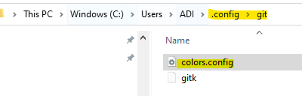
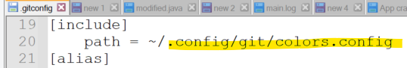
colors.gitconfig file
You can set font colors for some git commands.
You need to create a .config file that you will call from your .gitconfig file
# Color settings for 'git status'
[color "status"]
# To test HEX colors, https://www.colorhexa.com/
# Comments
header = "#999999"
# Changes to be committed
added = "#99CC99"
# Changes not staged for commit
changed = "#F08080"
# Untracked Files
untracked = "#FFCC66"
# Current branch name ("Font Color" "HighLight Color")
branch = "#2D2D2D" "#6699CC"
# Because the phrase "Detached HEAD" isn't unnerving enough
nobranch = bold ul blink "#F99157"
# Color settings for 'git diff'
[color "diff"]
# Information about the file we're scanning
meta = "#FFFFE0"
#
func = "#cc99cc"
# Code break
frag = "#00BFFF"
# Comments
context = "#FFFFFF"
# Previous changes ("Font Color" "HighLight Color")
old = "#F2777A" "#393939"
# New changes ("Font Color" "HighLight Color")
new = "#BEF2BE" "#A9A9A9"

Slide 11
SSH-Configuration

Slide 12
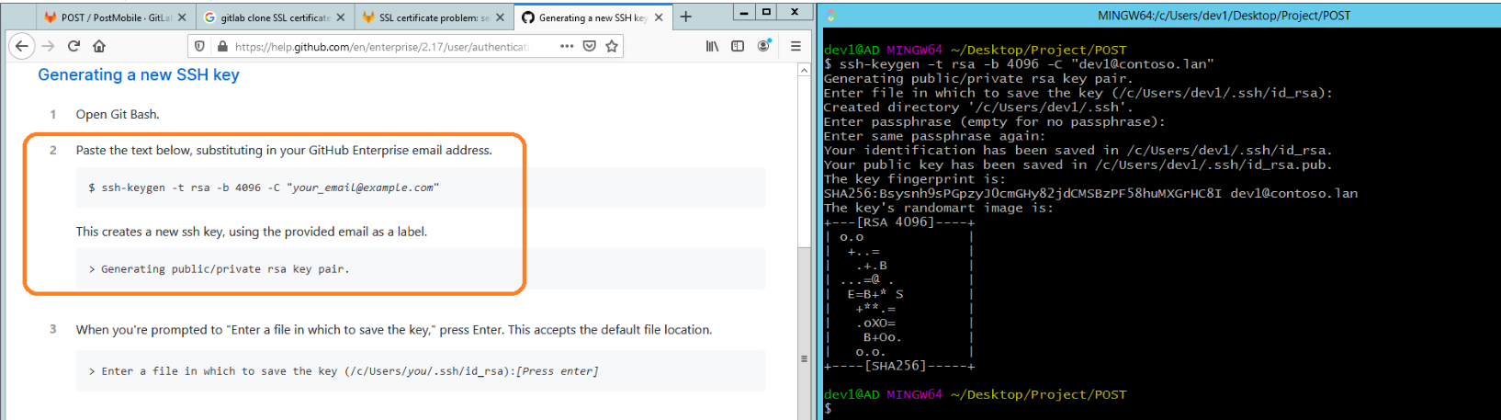
Git SSH connection
ssh-keygen -t rsa -b 4096
As we are using a self-signed certificate, the only option to clone our repository will be to use SSH connection.
The following steps :
ssh-keygen –t rsa –b 4096 –C “you@company.com”
Choose a personal password (I suggest a simple one just in case you are on hiatus).
Save the key in the default location (C:/Users/UserNama/.ssh/id_rsa)

Slide 13
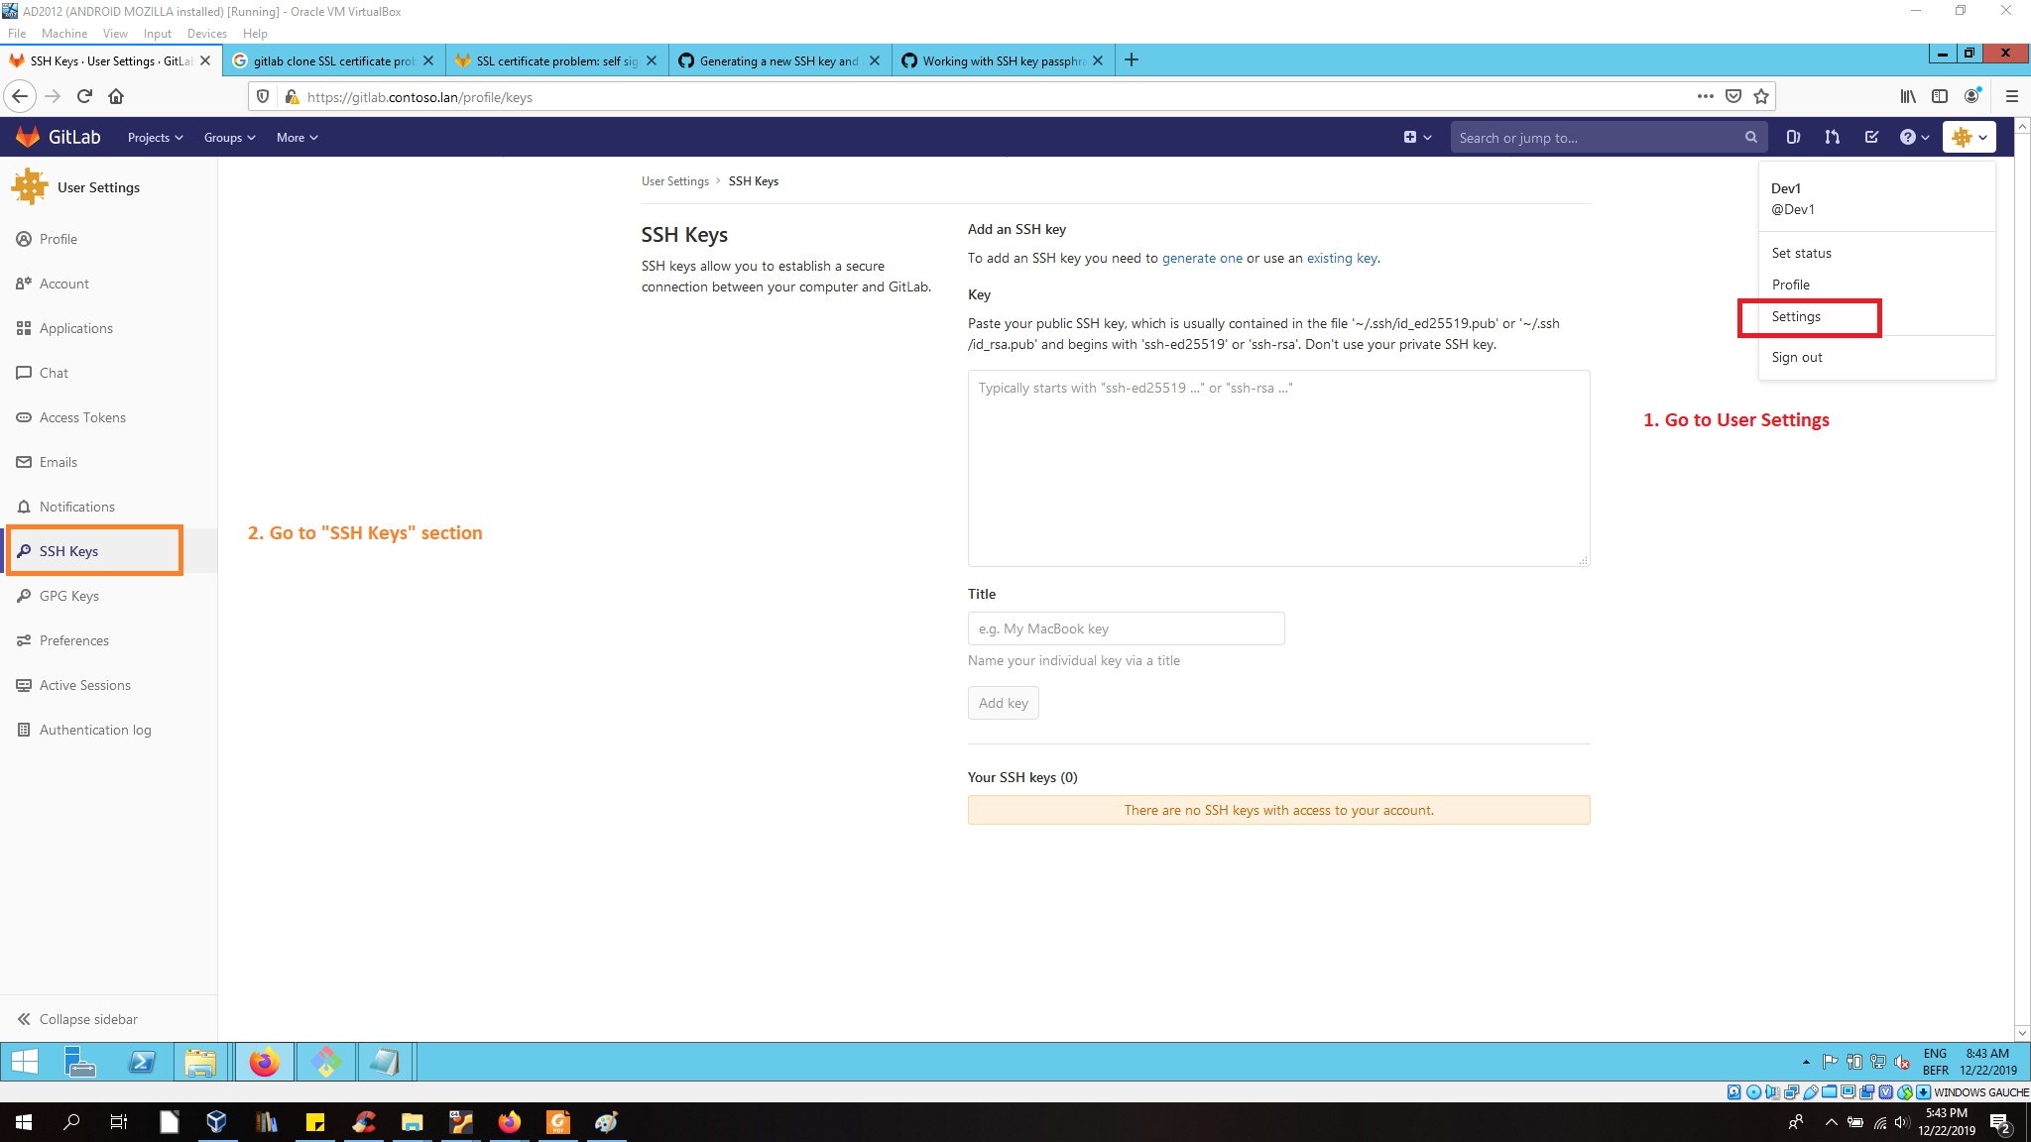
Git SSH connection
Copy the content of public key (C:/Users/UserNama/.ssh/id_rsa.pub)
Paste it on Gitlab
Copy-Paste public key content there

Slide 14
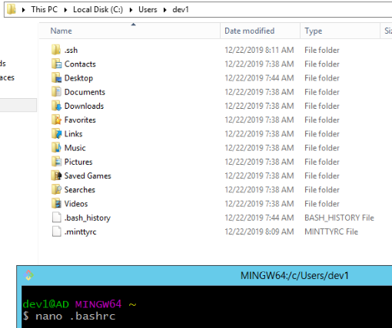
Git SSH connection (auto-launch ssh-agent)
Create a .bashrc file inside C:/Users/UserName : nano .bashrc

Slide 15
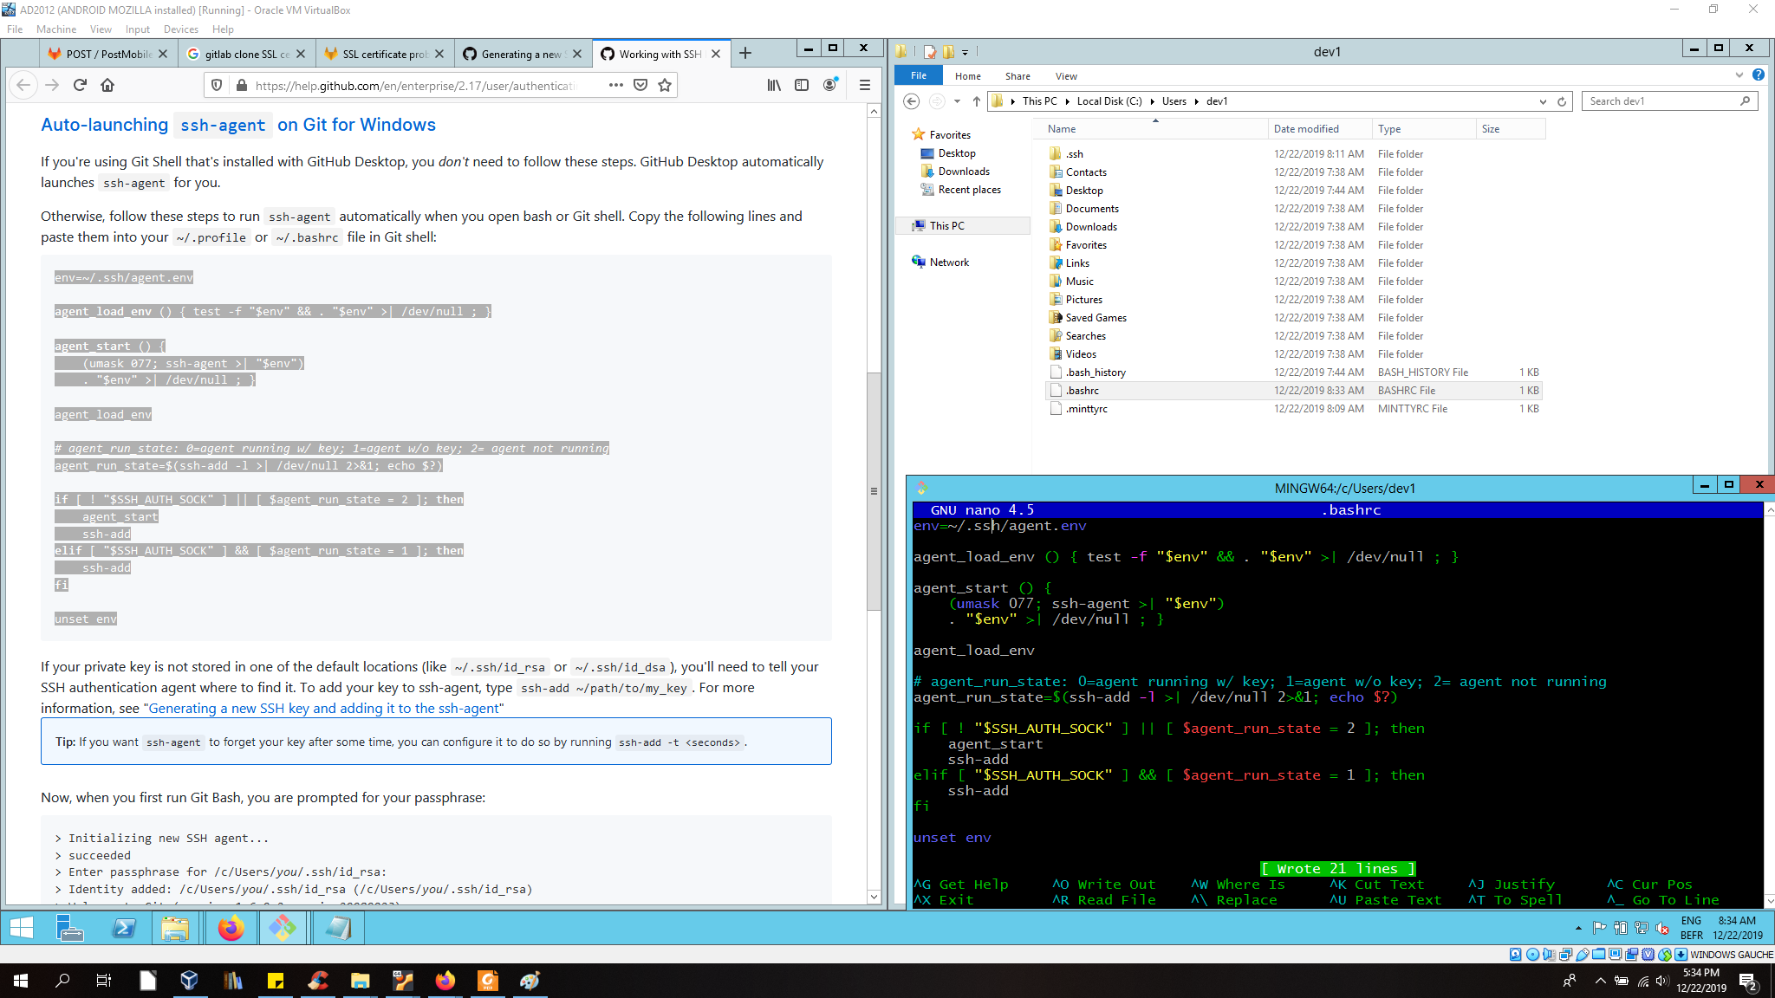
Git SSH connection (auto-launch ssh-agent)
Copy-paste the script from Github .

Slide 16
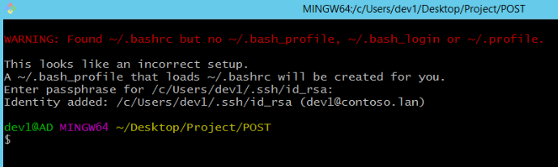
Git SSH connection (auto-launch ssh-agent)
Re open Git Bash and Git will create a .bash_profile file.
Now, until you log out your session, Git Bash will ask you only once your password.
If you encounter some issues for launching the ssh-agent, use the following commands:
eval “$(ssh-agent -s)”
ssh-add ~/.ssh/id_rsa

Slide 17
Git ignore

Slide 18
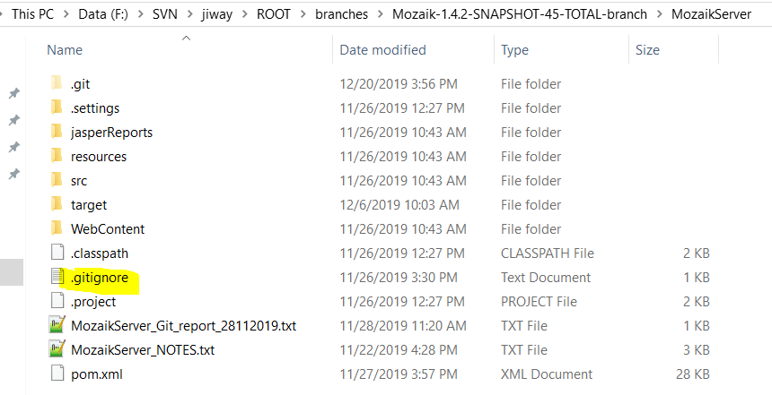
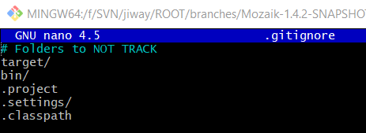
Git ignore
If your using Maven, I strongly advise to create a .gitignore file in the Project root!
With this file, Git will not track files created in target folder (when building a .war file for example)
nano .gitignore

Slide 19
Git fork

Slide 20
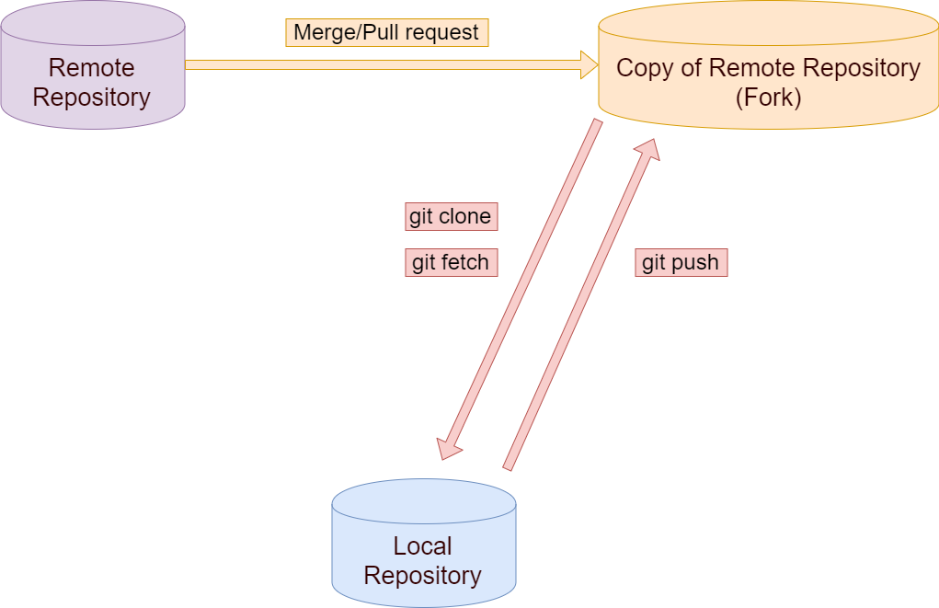
Git fork
A fork is a clone of a remote repository from server side. Forking a repository allows us to freely experiment with changes without affecting the original project).
The project manager could create a copy in case of wrong commits.

Slide 21
Git (Basic Command Lines)

Slide 22
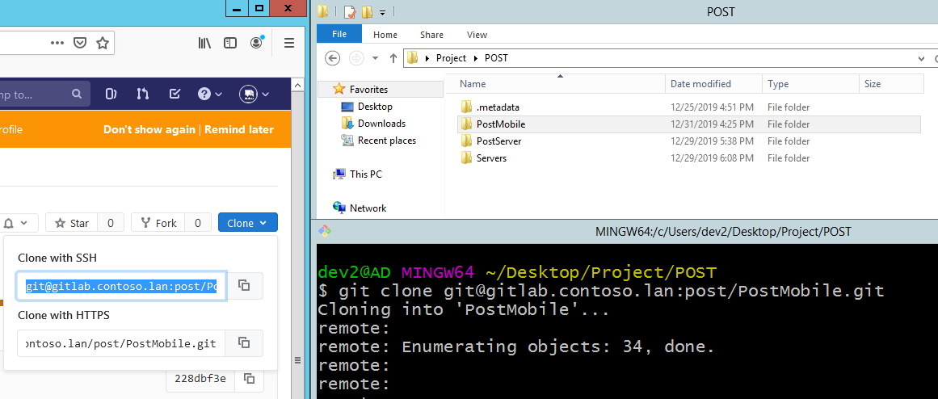
Git clone
Command used to target an existing repository and create a copy.
When a repo is cloned, it has a default remote called origin that points to this remote repo.
git clone <git@repository_url>

Slide 23
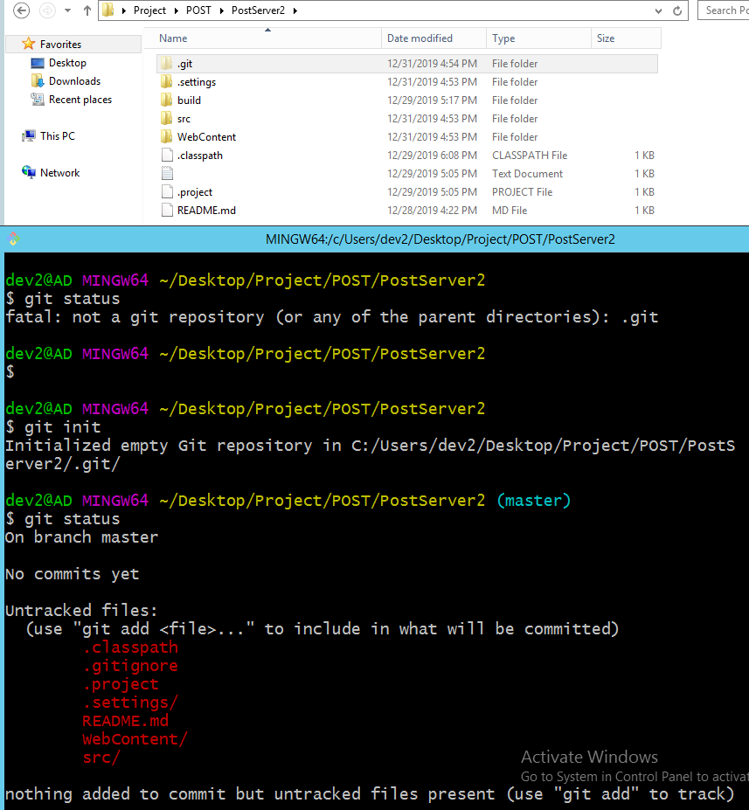
Git init
Instead of using git clone, we can just create an empty git repository inside an existing project and add/push all our commits to the remote repository.
git init

Slide 24
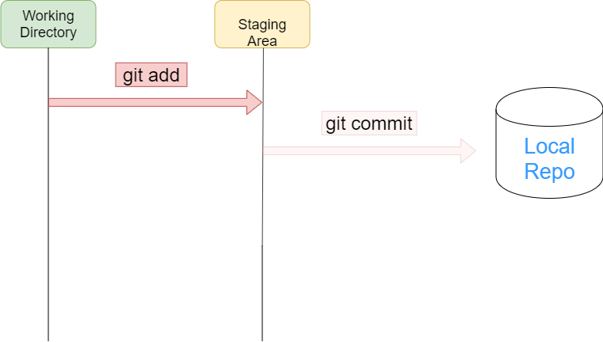
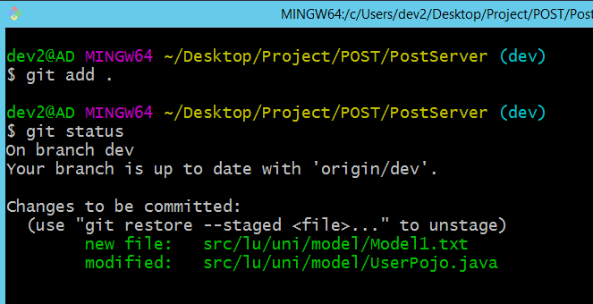
Git add
The git add command adds a change in the working directory to the staging area (a preview of your next commit).
To add a specific change: git add <changedFile_path>
To add ALL uncommited changes : git add .

Slide 25
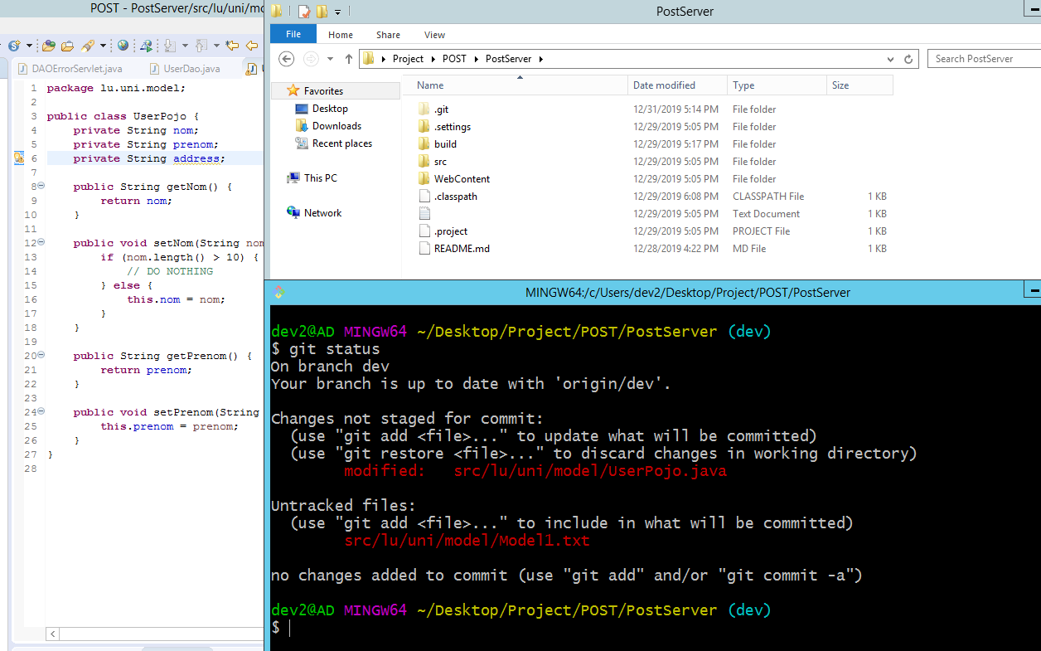
Git status
The git status command displays the state of the working directory and the staging area. It lets you see which changes have been staged, which haven’t, and which files aren’t being tracked by Git.
git status
1. I added a new attribute
2. Git detects a modification in the java file
3. In the meantime, I added a new file (untracked file)

Slide 26
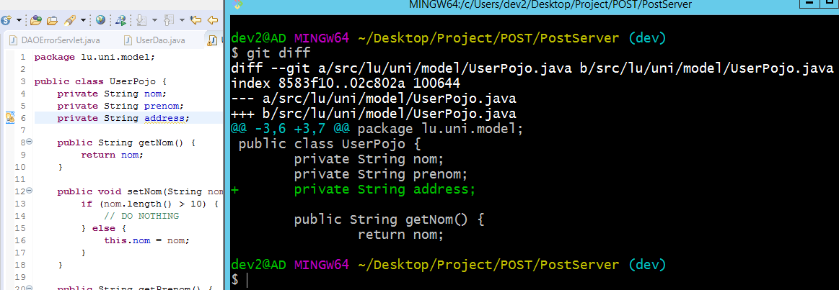
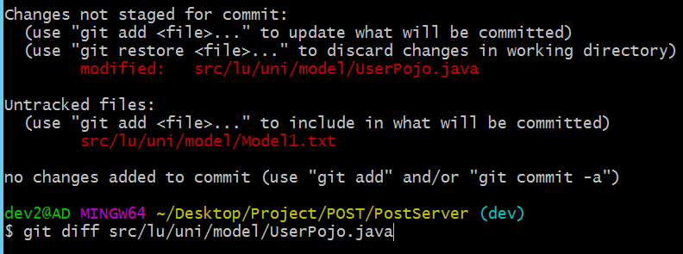
Git diff
git diff will display all changes in the entire working directory (Pic_1):
Added lines (green)
Deleted lines (red)
You can also select which change you want to review (Pic_2).
git diff <specific_change>
(Pic_1)
(Pic_2)

Slide 27
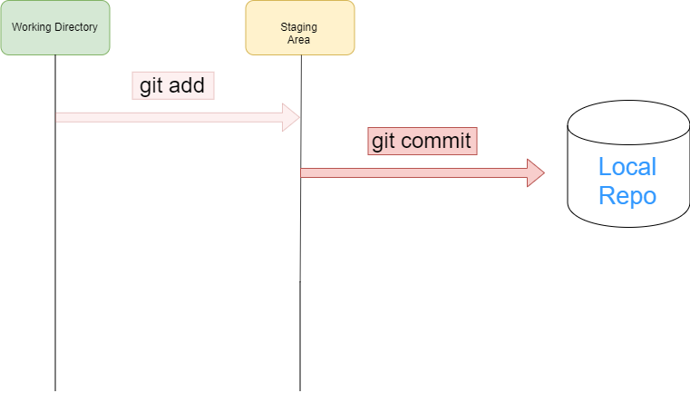
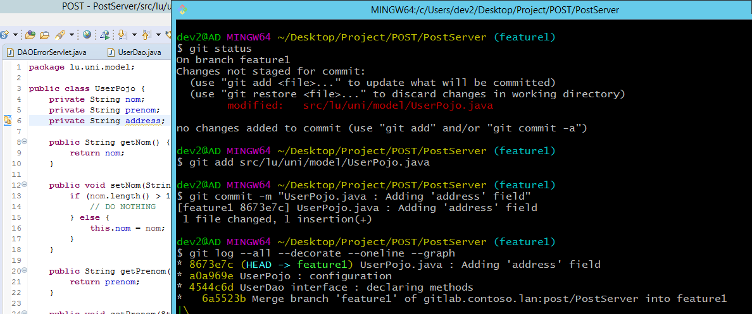
Git commit
The git commit command captures a snapshot (state at a certain time) of the project (with the currently staged changes).
You need to add a message before committing git commit –m “Description”
You can also add more than one line like this :
git commit –m “Description 1 (then type ENTER)
Description 2 (then type ENTER)
Description 3”

Slide 28
Git commit --amend
The following context:
You’re adding comments
You commit
You notice you forget to add more comments
Instead of creating a new commit, you can change the previous one to include your new changes with the following commands:
git add . Or git add <changedFile_path>
git commit --amend
An editor will open (nano editor) where you can:
Edit your commit message
Save / Overwrite the file by typing CTRL + O
Quit the file by typing CTRL + X

Slide 29
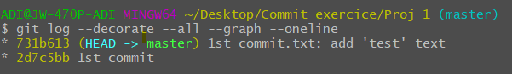
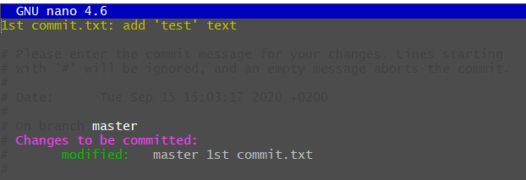
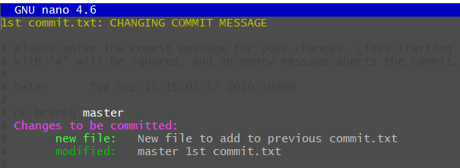
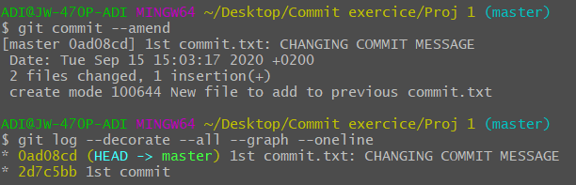
Git commit –amend (screenshots)
We have 2 commits: 2d7c5bb & 731b613.
By typing git commit --amend, we will edit our last commit 731b613 to change the commit message.
When saving with Ctrl + O, and quitting with Ctrl + X, :
We can see the commit message changed
All new changes (new added file, modification) are done.

Slide 30
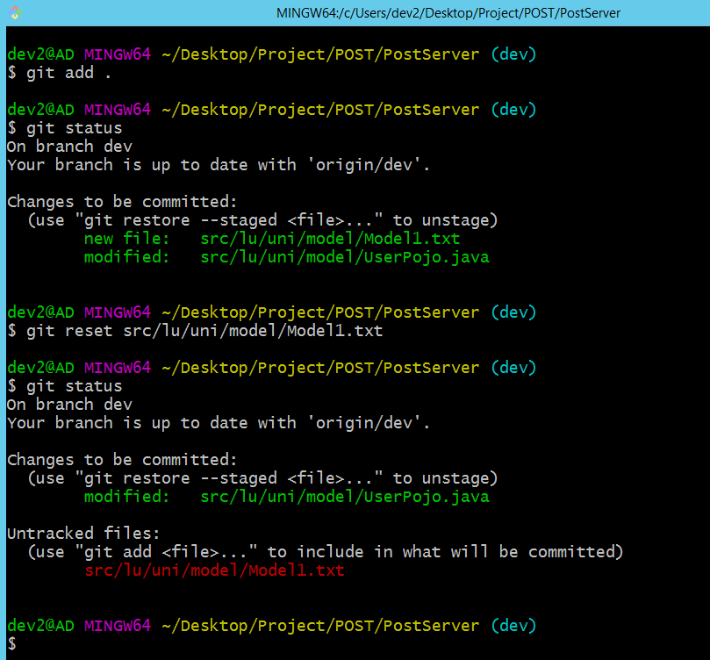
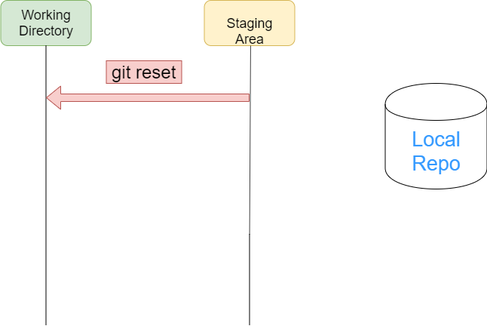
Git reset
Reset the staging area to match the most recent commit but leave the working directory unchanged.
git reset <file> removes the specified file from the staging area.
git reset removes all specified file from the staging area.
‘Model1’ staged
Git reset of ‘Model1’
‘Model1’ unstaged

Slide 31
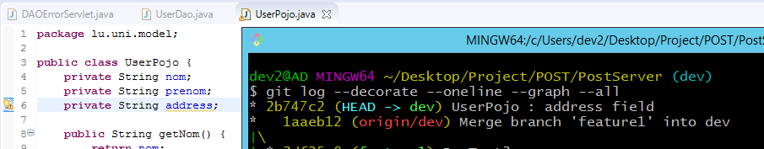
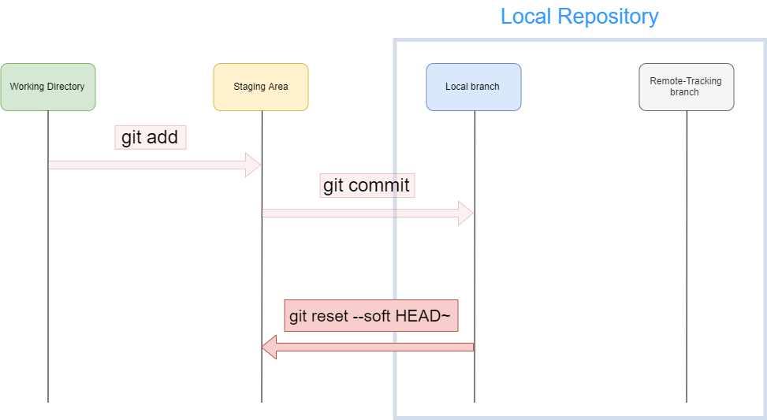
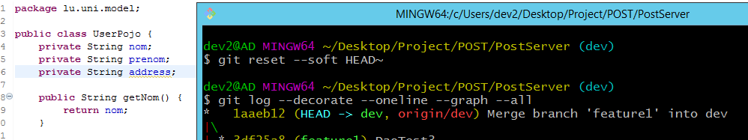
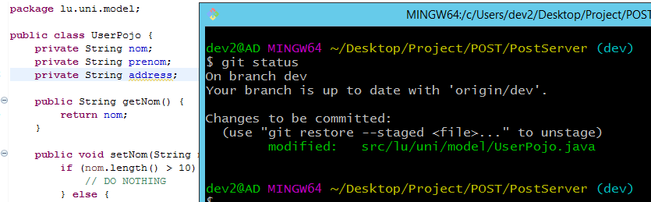
Git reset --soft HEAD~ (Windows)
This command will remove the last commit from the current branch.
But all staged files (in staging Area) remained.
You can add more unstaged files.
We’ll remove
UserPojo : address field
Our last commit is now
Merge branch

Slide 32
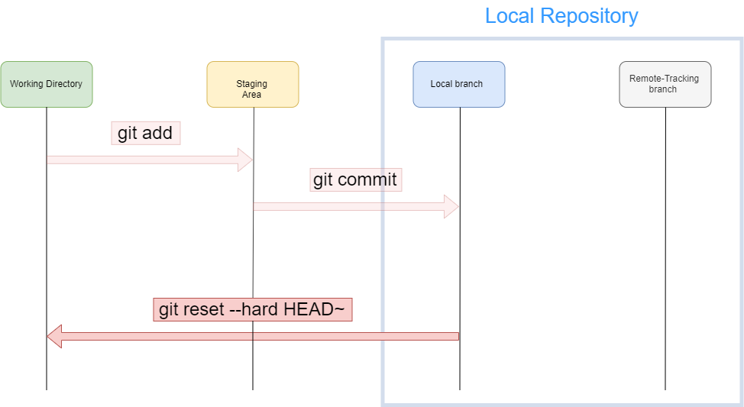
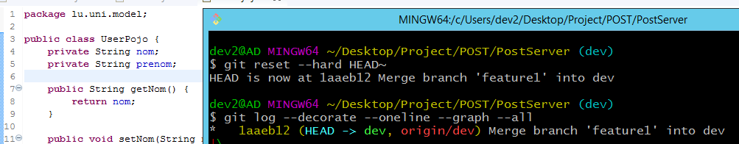
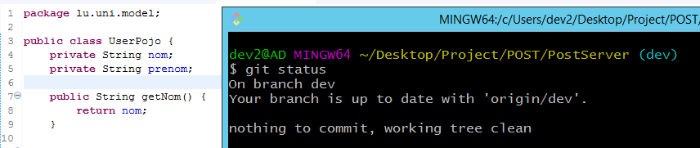
Git reset --hard HEAD~ (Windows)
Like the previous one, it will also remove the last commit from the current branch.
CAUTION: All staged files (in staging Area) are also completely deleted.

Slide 33
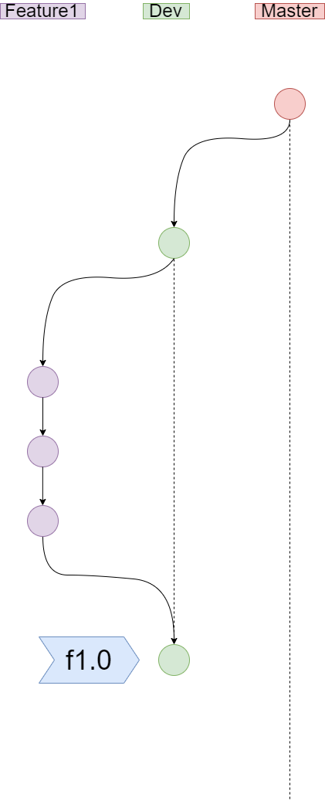
Git tag
Tags are ref's that point to specific points in Git history.
Useful as shortcut when we have to review some specific commits (among 100 commits for a project for example)
To show a list of tags, type git tag
To create an annotated tag (with message) at a specific commit, type
git tag –a <annotation> <commit_Id> -m “Message”
To create a non-annotated tag (much simpler) at a specific commit, type
git tag <annotation> <commit_Id>
Don’t use white spaces for tag annotations (not allowed)
To add a tag on remote repository, type :
git push <remote_repo_alias> <tag_name>
To add all tags at ONCE on remote repository, type :
git push <remote_repo_alias> --tags

Slide 34
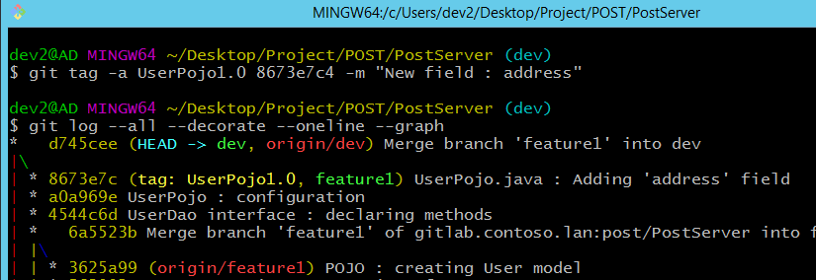
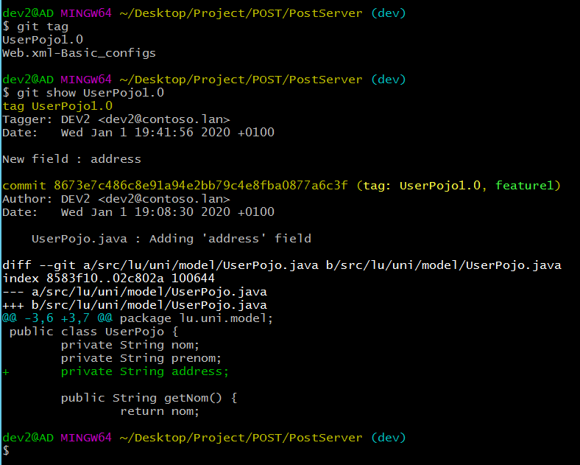
Git tag (screenshots Part 1) for annotated
1. As annotation, I used ‘UserPojo1.0’ without white spaces
2. git tag displays a list of already existed tags
3. git show <tag_name> displays the following information :
Tag message
Description

Slide 35
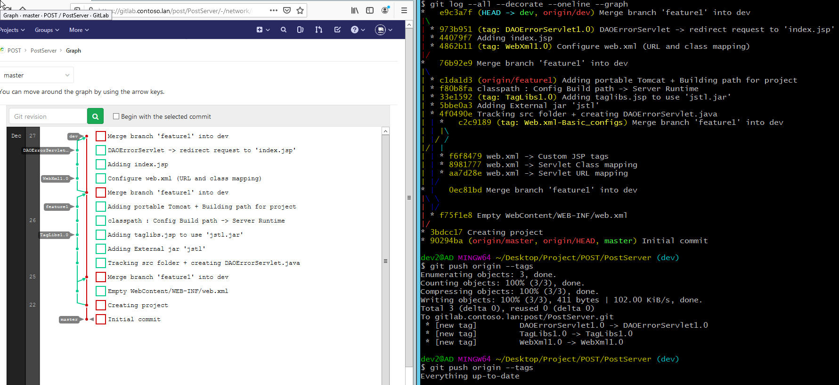
Git tag (screenshots Part 2) for annotated
To push ALL tags on remote repository, you must type :
git push <remote_repo_alias> --tags
You can notice that Git checks if some tags are missing on the remote repo.

Slide 36
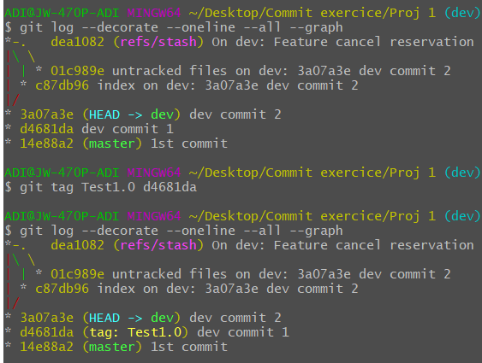
Git tag (screenshots) for non annotated
Non annotated tag.

Slide 37
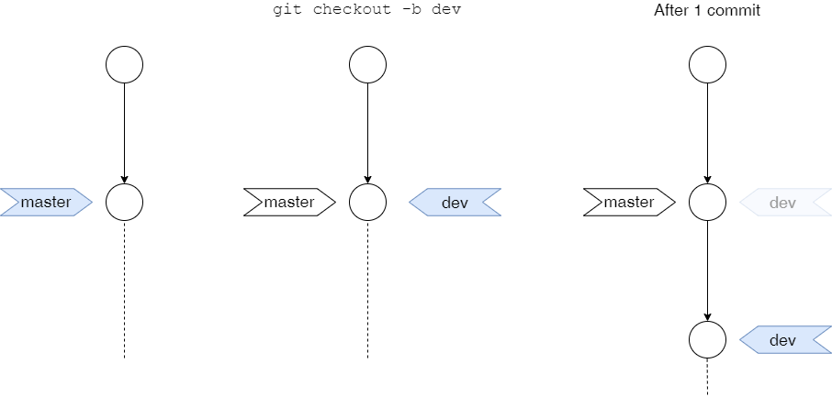
Git checkout
git checkout <branch_name> lets you navigate between the branches created by the command git branch
You can also create new branches by typing git checkout –b <new_branch>
In fact, git will create a new ref pointer.
The dev pointer moves

Slide 38
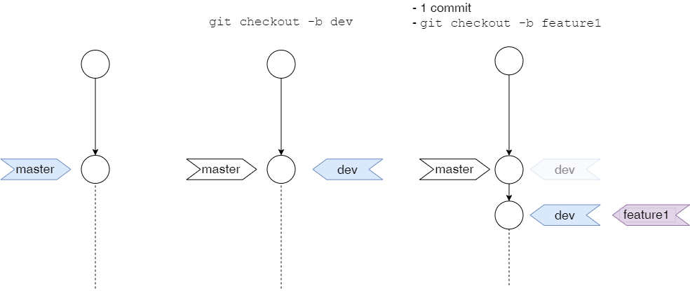
Git checkout (ideally)

Slide 39
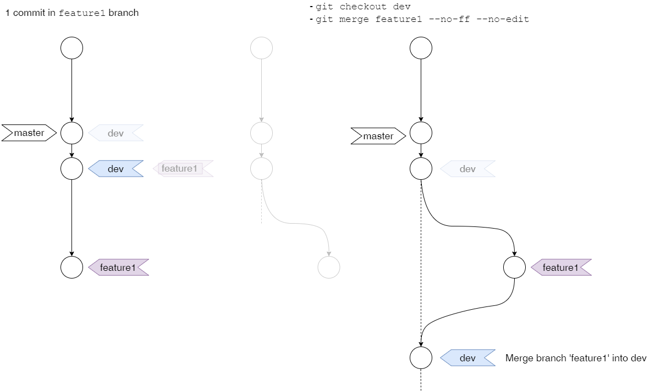
Git checkout (ideally)

Slide 40
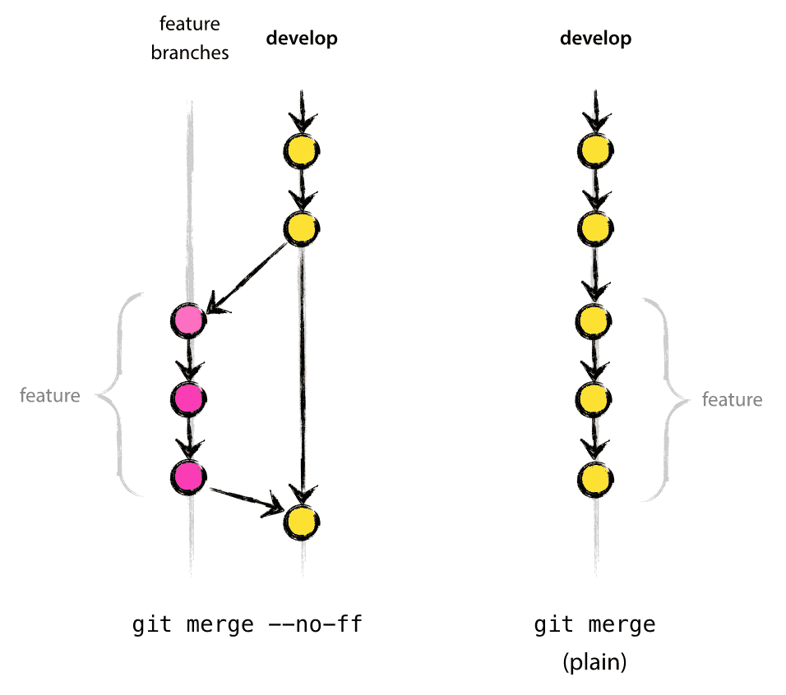
Git merge
git merge will combine multiple sequences of commits into one unified history.
It is used to combine two branches
Non Fast Forward Merge
It merges the specified branch into the current branch, but always performs a merge commit.
Use this option if you want to keep a certain topology : it helps creating a more readable history.
Recommended
Fast Forward Merge
It will integrate the commits from the specified branch into the current branch.
Option by default
Image source : https://nvie.com/posts/a-successful-git-branching-model/

Slide 41
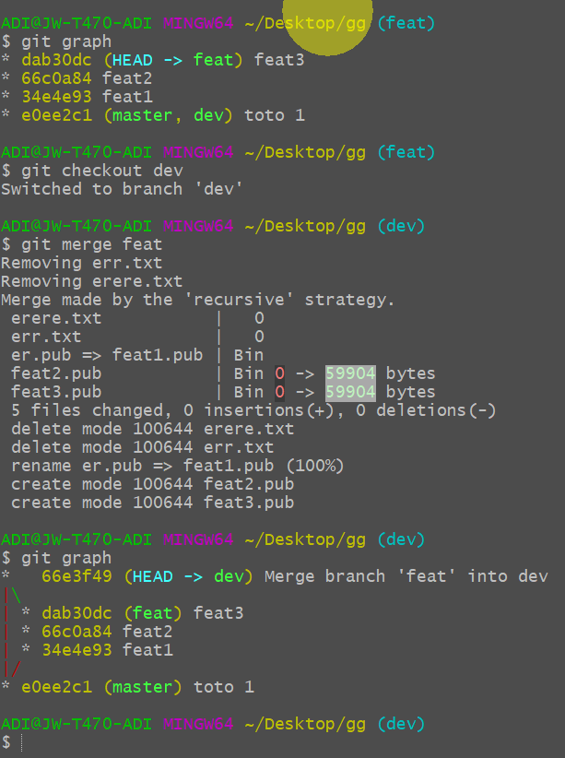
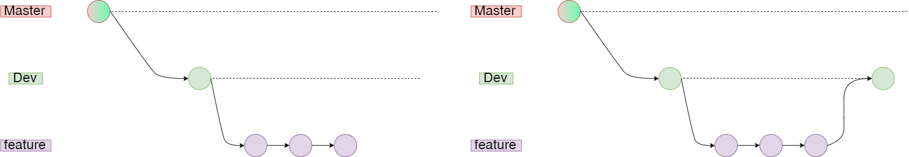
Git merge (Remark 1)
We go back from feature branch, using git checkout dev
When doing git merge feature, only the dev branch pointer will move.
feature branch pointer remains at the same place.
git merge feature –no-ff –no-edit

Slide 42
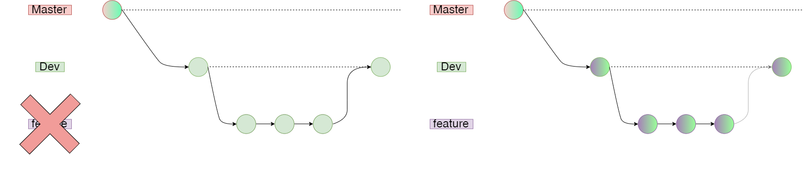
Git merge (Remark 2)
To “separate” each merge, after having merged with feature branch :
Delete feature branch : git branch –d feature
Recreate it (like this, its pointer will be at the same commit than dev) : git checkout –b feature
Do your commits as usual and merge into dev
git branch –d feature
git checkout -b feature

Slide 43
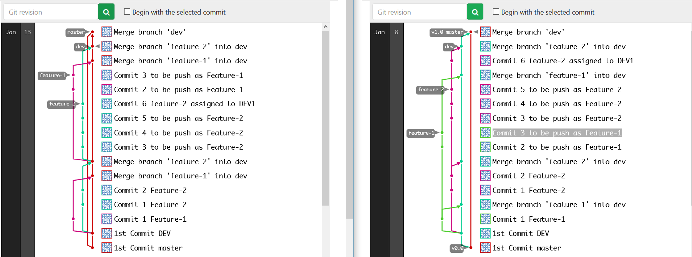
Git merge (screenshots)
When you «separate» merge

Slide 44
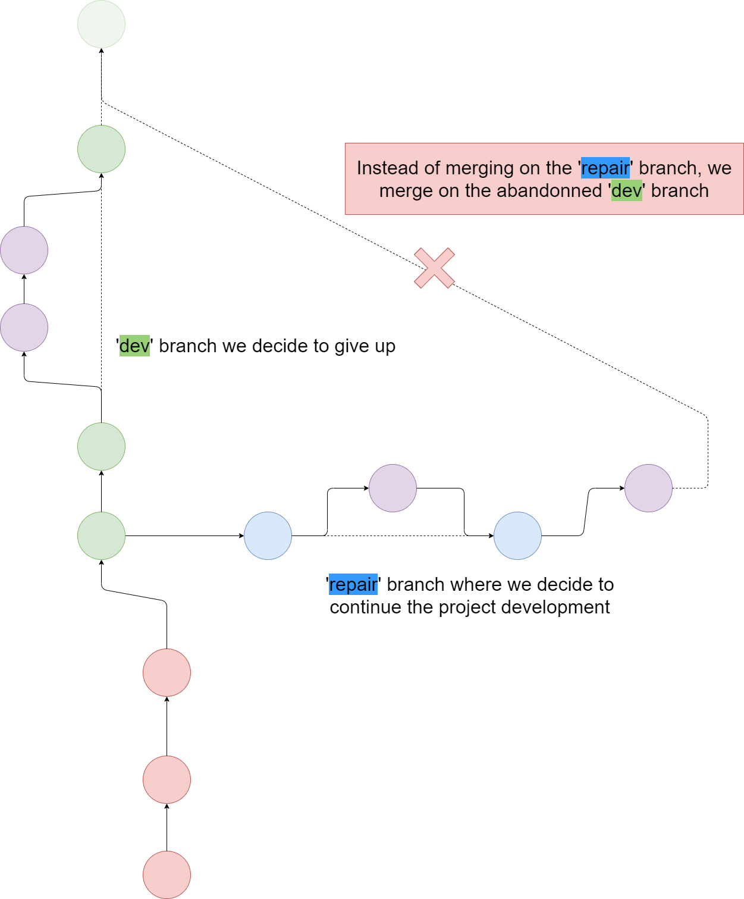


Git merge (CONFLICT)
You can encounter this case if you decide to merge with a wrong branch
La solution:
git merge --abort

Slide 45

How to look the branches ?
Like stacked branches

Slide 46
Git remote
The git remote command lets you create, view, and delete connections to other repositories.
The following options :
Will create a new connection to a remote repository. When cloning a remote repo, it will create by default a shortname origin mapping to remote repo’s URL.
git remote add <shortname> <repository_url>
This command will display a list of shortnames with their associated remote repo’s URL.
git remote –v
It will just disconnect the remote from the local repository (the remote repo is not deleted).
git remote remove <shortname>

Slide 47


Git remote (screenshots)
Where git remote could be useful : managing a remote repo and its forks.
Fork = copy of remote repo
2. If you decide to create a fork of this remote repo (to avoid to corrupt your original repo with wrong Git commands), instead of cloning the repo, you can only add a shortname pointing to its URL and after update its branches.
1. When cloning a repo, a remote named origin is created, pointing to the URL where you cloned your repo

Slide 48

Git remote (screenshots)
My opinion : the scenario to avoid (creating a common .git folder for all projects) !
Instead :
Each project has its .git folder and we avoid mixing with history commits from other projects.
The ‘origin’ remote branch will point to the respective URL

Slide 49
Git push
git push is used to transfer local commits to the remote repository. It is advised to specify from which branch we want to push our commits :
git push <remote_name> <branch_name>
We also use this command to transfer all local tags to the remote repository. Tags are not automatically pushed when you push a branch. The --tags flag sends all of your local tags to the remote repository.
git push <remote_name> --tags

Slide 50

Git push (screenshots)
Please pay attention at the colors in the circles. Each color represent a branch.
Master
Master
Remote repository
Dev
Dev
Feature1
Feature1
Local repository
In the 1st case, until now, we didn’t push our feature1 local branch.
Thus, the remote repo doesn’t have any feature1 ref pointer
In the 2nd case, we are in our feature1 local branch and we proceed with git push
Now, we updated the remote repo with a feature1 ref pointer

Slide 51


Git push origin --tags (screenshots)
Locally, we created 3 tags :
test1.0
test1.1
test1.3
But we didn’t push them yet.

Slide 52

Git fetch
Like git pull, this command is used to download commits and refs from a remote repository into your local repo.
The command git fetch alone doesn’t force to actually merge the changes into your working directory (Safer than git pull).
I would ADVISE to use this (instead of git pull) : when doing commits in feature local branch, you don’t need to switch to your dev local branch to update it with the commits from remote repo.
git fetch -u <remote> <remoteBranch>:<localBranch>

Slide 53

Git fetch (schema)
Remote repository
git fetch origin dev:dev
Dev
Dev
Dev
Local repository (Developer 1)
Feature
Feature
1. DEV1 is still on feature local branch and has finished with commits.
git checkout dev
git merge feature

Slide 54

Git stash
If you’re asked to work on an urgent bug fix and you still have changes not ready to be committed, when switching to another branch, you’ll get this warning message :
The git stash command allows you to put your ‘uncommitted changes’ in a temporary location. By default, git stash will stash only modified and staged tracked files.
For our usage, to include untracked files as well (new added files, we will use
git stash push –u –m “Description”
To stash only unstaged files (modified files we don’t add with git add), the command is:
git stash -k

Slide 55


Git stash (context)
Master
Remote repository
Dev
Master
Local repository (Developer 1)
Dev
Feature
DEV 1 is on feature branch and was doing some changes (unstaged & staged > uncommitted files)
Controller3.java
PojoCar.java

Slide 56


Git stash (context)
Master
Dev
Feature
DEV 1 saves the unstaged & staged > uncommitted files in a temporary location
Controller3.java
PojoCar.java
master
master
Dev
Feature
DEV 1 then can switch to master branch to creates a bugfix branch
bugfix

Slide 57



Git stash push (schema)
Files (not yet added in Staging Area) :
Modifying Feature Commit 3 DEV2
Adding new (untracked) file New Added File
3. To list all stash :
git stash list
Putting the unstaged (including staged > uncommitted) changes into stash :
git stash push –u –m “Modified File 3 + New File”
Feature Commit 3 DEV2.txt
New added file.txt

Slide 58

Git stash (show content before restoring it)
When you have a list of stash id where you stored specific unstaged files, you would like to check their content before retrieving the files.
The command to show the content for a specific stash id is:
git stash show –p stash@{<id>}
0. git stash list will show a list of stash ids. Here we have only stash@{0}
git stash show –p stash@{0} will show the content of stash@{0}

Slide 59

Git stash pop (schema)
Git stash pop is used to remove a single stashed state from the stash list and apply it on top of the current working tree state.
Feature Commit 3 DEV2.txt
New added file.txt
After fixing the bugs, go back to your branch and retrieve specific stash:
git stash pop stash@{0}

Slide 60

Git stash apply (more safer than git stash pop)
Git stash apply is used to retrieve the content of a stashed state from the stash list without dropping it : this means you can reuse the stashed state later.
To drop it, uses git stash drop
0. stash@{0}: we just added lines into dev commit 2.txt
We will retrieve the content of stash@{0}
2. We kept a copy of stash@{0} to reuse later
3. If we want to definitely delete stash@{0}

Slide 61


Gitk & git log
Used to display commit topology.
gitk -–all
git log -–decorate -–oneline -–graph –-all

Slide 62

Git log --graph --oneline --decorate --all (with alias)
To avoid calling this long method, we will create an alias.
git config --global alias.<chosenName> ‘log -–decorate -–oneline -–graph –-all’

Slide 63
Git (Finishing a teammate work)

Slide 64

Branching (when you have to finish a teammate work)
jde et iwe clone the repository & do their commits on their respective feature branch
Remote repository
git clone <RemoteRepo_URL>
JDE
git checkout –b feature-jde
git commit –m “Description”
git checkout –b feature-iwe
git commit –m “Description”
IWE

Slide 65

Branching (when you have to finish a teammate work)
jde et iwe, while working on their feature branch ,push their commits on the remote repository
JDE
git push origin feature-jde
IWE
git push origin feature-iwe

Slide 66

Branching (when you have to finish a teammate work)
Iwe merge the commits from feature-iwe into local dev local branch.
git checkout dev
git merge feature-iwe
IWE

Slide 67


Branching (when you have to finish a teammate work)
Iwe push her commits to remote repository.
Before
git push origin dev
IWE

Slide 68

Branching (when you have to finish a teammate work)
Jde, still on his feature local branch, must update his dev local branch
git fetch origin dev:dev
JDE

Slide 69

Branching (when you have to finish a teammate work)
Some days later, unfortunately, jde is on hiatus. Iwe must finish his work.
git fetch origin feature-jde:feature-jde
IWE

Slide 70

Branching (when you have to finish a teammate work)
Iwe do some commits. Then switch to dev branch and merge.
git commit –m “Description”
git checkout dev
git merge feature-jde
IWE

Slide 71

Branching (when you have to finish a teammate work)
Iwe push the commits for dev only. After she deletes feature-jde branch (local and remote)
Please pay attention : the feature-jde pointer is still at the same place
git push origin dev
git branch –D feature-jde
git push origin –delete feature-jde
IWE

Slide 72

Branching (when you have to finish a teammate work)
Jde comes back and must update his dev branch only. As he was on feature-jde branch, he just have to use git fetch origin dev:dev.
git fetch origin dev:dev
JDE

Slide 73

Branching (when you have to finish a teammate work)
Then Jde switches to dev branch and delete feature-jde branch
git checkout dev
git branch –D feature-jde
JDE

Slide 74

Branching (when you have to finish a teammate work)
Jde has to recreate feature-jde branch (its pointer will point at the same commit than dev pointer)
git checkout -b feature-jde
JDE

Slide 75
Git (Command lines summay)

Slide 76


Git clone & init
To clone a remote repository :
git clone <RemoteRepo_URL>
To create a new git local repository (in the case of an existing but NOT TRACKED project):
git init

Slide 77


Git status & diff
To display the list of changes :
git status
To review changes,
git diff <specific_change>
git diff (for all changes)

Slide 78


Git add, reset & commit
To add your changes to the Staging Area :
git add <specific_change>
git add . (for all changes)
To undo your staged files :
git reset <file>
git reset (for all changes)
To commit your changes :
git commit –m “Description”
git commit –m “Description 1 (then type ENTER)
Description 2 (then type ENTER)
Description 3”
Local
Repository
Remote
Repository

Slide 79




Git stash
In case of you are called to fix a bug and switch to master branch, save ALL your unstaged contents (–u includes untracked contents) :
git stash push –u –m “Description”
When bugs are fixed, you can recover the unstaged contents after having switched back to your feature branch:
git stash pop
git stash pop <Selected_Stash>
Controller3.java
PojoCar.java
Stashing only tracked files
Stashing with untracked files
Controller3.java
PojoCar.java

Slide 80

Git fetch & merge
Before merging your commits from feature local branch, if in the meantime one of your teammate has pushed its commits, update your dev local branch (directly from your feature local branch)
git fetch -u <remote> <remoteBranch>:<localBranch>
After updated your dev local branch ,switch into it.
git checkout dev
Then do git merge feature (if you have correctly configured git).

Slide 81


Git push & tag
For each release or f you consider the commit as major, tag it :
git tag –a <annotation> <commit_Id> –m “Message”
If you’re still working on feature local branch, push the commits before leaving building (just in case of you take leave)
git push origin feature
Push your dev & feature local branch to remote repository. Push tags as well
git push origin dev
git push origin feature
git push origin –-tags

Slide 82


Slide 83


